Slide 1
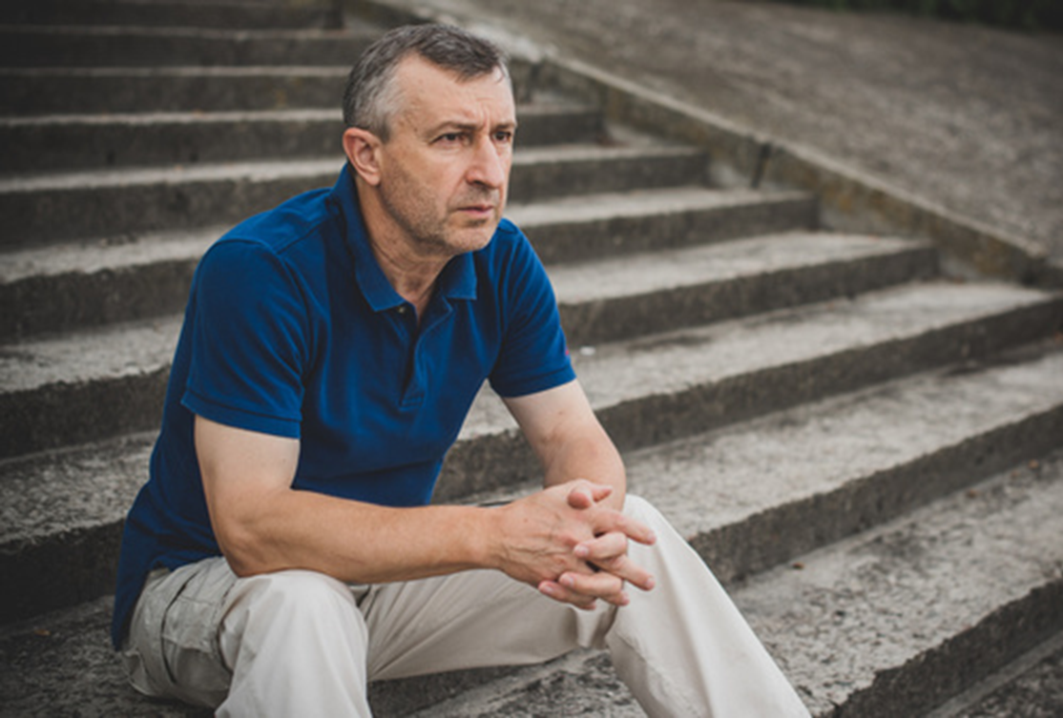
COPING WITH ANXIETY
Coping with anxiety is something millions of people deal with on a daily basis. Dealing with anxiety, fear, loneliness, frustration, anger, and countless other emotional burdens can be draining.
If you’re concerned about a rise in your level of anxiety, then complete the Beck Anxiety Inventory and take appropriate action by chatting to a Mental Health First Aider or calling the Employee Assistance Programme – it’s completely confidential.

Slide 2
TIPS TO REDUCE ANXIETY Communication is key
Everyone needs human interaction to thrive emotionally. Research has long-supported the idea that strong social bonds strengthen people’s mental health. Although it wouldn’t be considered healthy to go all-in on social media if physical interaction were an option, finding community on WhatsApp, Instagram and Twitter is a coping method in the digital era. Of course, it’s critical to practice positive and healthy social media engagement.

Slide 3
TIPS TO REDUCE ANXIETY Have a daily routine
Having a daily routine can help to keep your mental health sharp. Coping with anxiety can be counteracted by purpose and structure. Create a schedule and stick to it.

Slide 4
TIPS TO REDUCE ANXIETY Keep in touch
Prioritise time with your family, friends, and co-workers. Facetime them, get on a Zoom call, or just call them the old-fashioned way. No matter the form of communication, make sure you are taking the time to talk, laugh, and be open with the meaningful people in your life. Now isn’t the time to limit interaction, it’s time to enhance it.

Slide 5
TIPS TO REDUCE ANXIETY Go outside
With social distancing in mind, be sure to go outside and get some fresh air. Even if you just step outside a few times a day, everything helps.

Slide 6
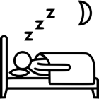
GET SOME REST
Wake up at the same time.
Before bed, relax – read, take a warm shower or bath, listen to soft music.
Avoid caffeine, alcohol and chocolate after 12.
Make sure your bedroom is cool, dark, quiet.
30 minutes before bed turn off screens.
Lights out same time.

